Slide 1
Manifesto for Labour Law
towards a comprehensive revision of workers’ rights

Slide 2
Ministry of Labour
Giving workers a voice
Carolyn Jones, Director, IER. May 2018

Slide 3
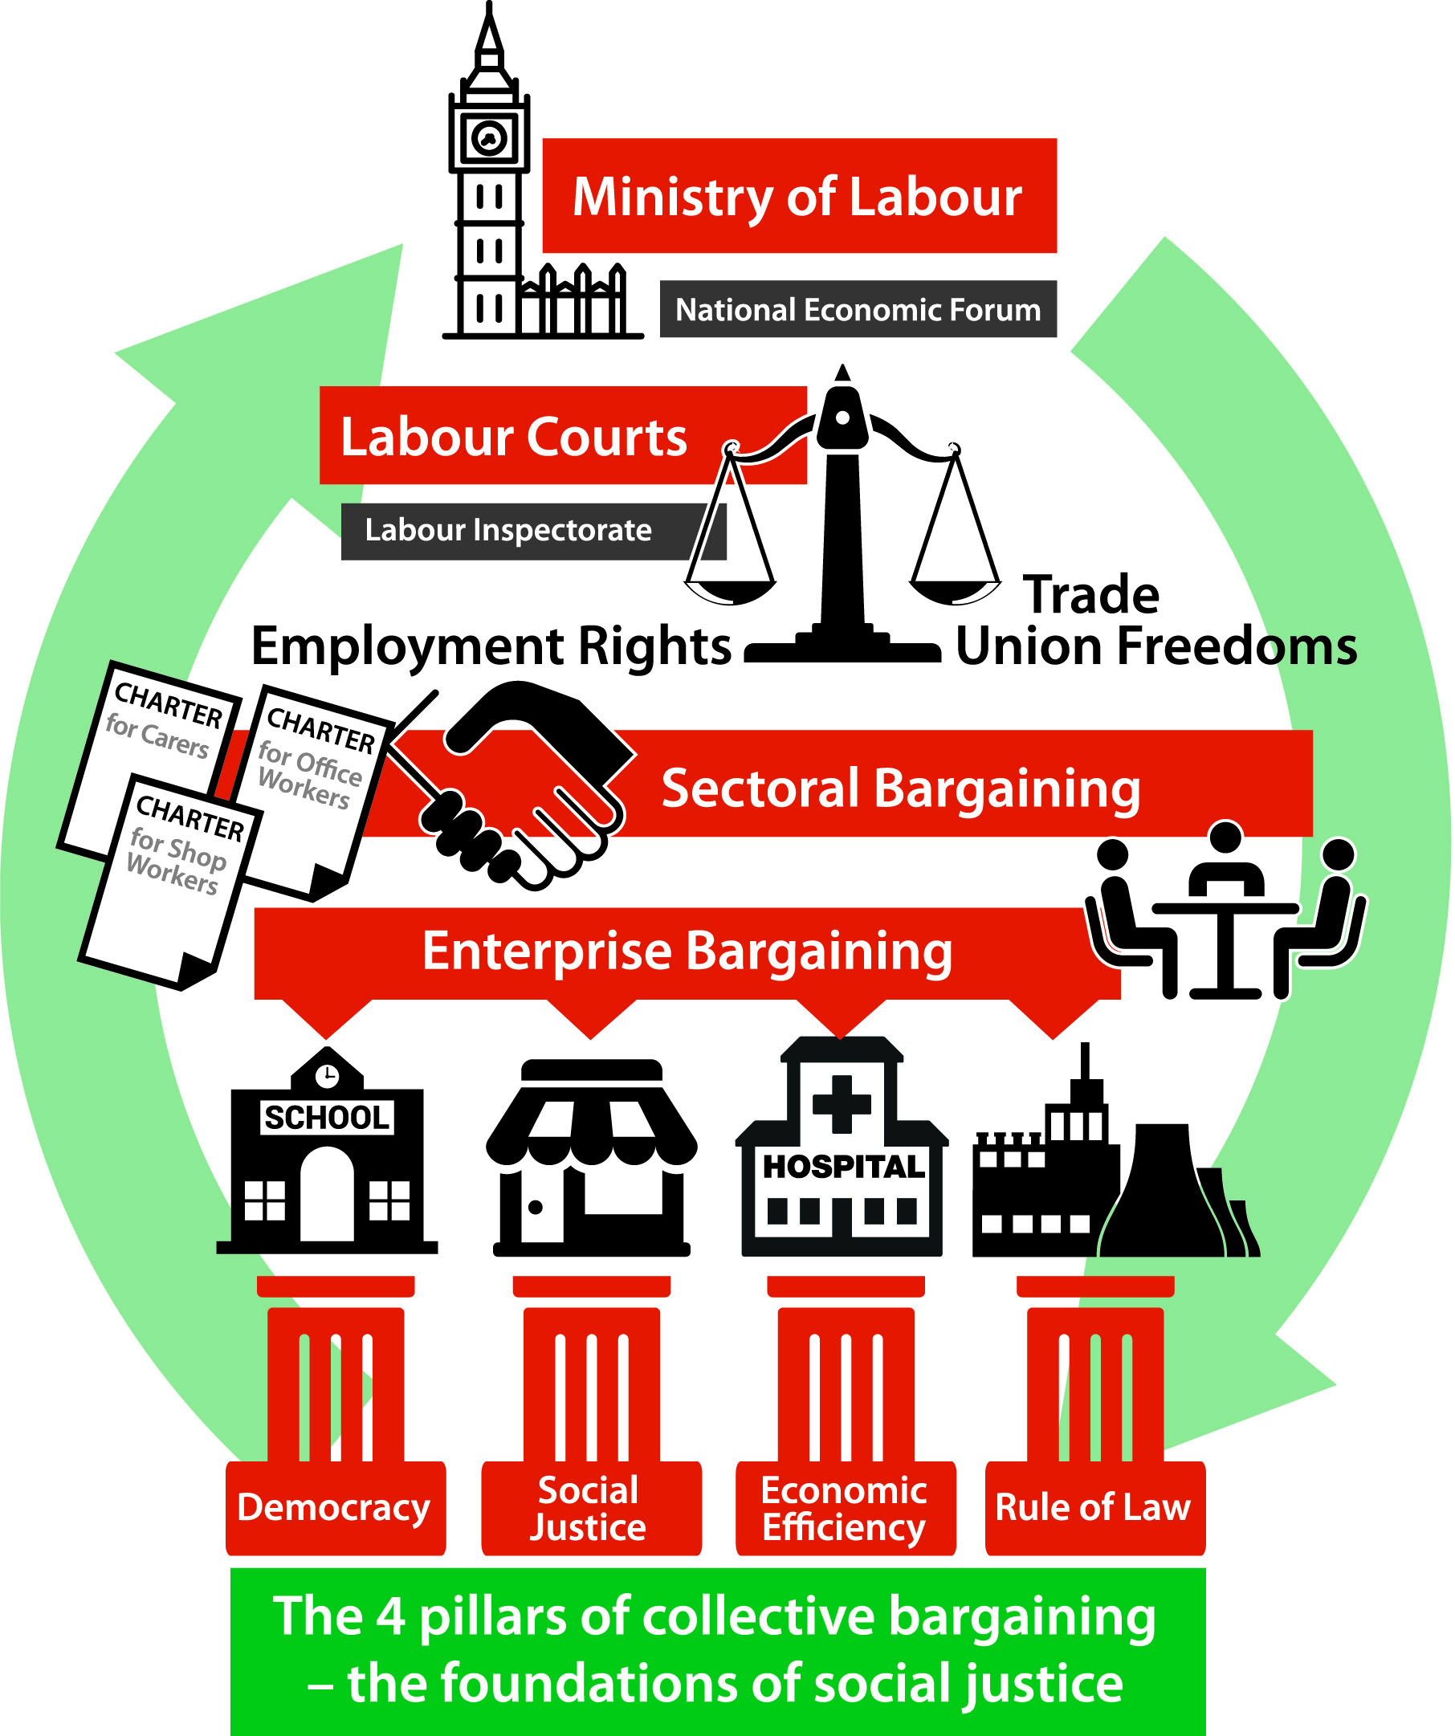

Slide 4
Past and Future
Ministry of Labour not a new idea in UK or in Europe
Past
First established by Ministries and Secretaries Act, 1916
Department of Employment was abolished by Thatcher
Future
Use of Prerogative powers
Statutory powers under Ministers of the Crown Act 1975
So no need for primary legislation – quick and obstruction free!

Slide 5
General Roles and Responsibilities
Provide a strong voice at the heart of Government for UK’s 33 million workers
Establish a National Economic Forum with Treasury Department
Provide a link across the many Departments impacting on labour market
3 specific major tasks

Slide 6
Rolling out Sectoral Collective Bargaining
Establish National Joint Councils in each industry
Encourage employers and unions to meet, agree scope, procedure, terms, application and enforcement issues for their sector
Establish national level cross-sector structures to develop and deliver employment policy, economic planning and labour standards
Provide a natural place for unions and employers to meet, discuss and reach agreement on industrial issues

Slide 7
Modernising Labour Relations
Still need safety net of statutory employment rights - clarify, simplify.
Universal definition of worker
End blacklisting and ZHC
Modernise H&S laws to reflect fragmented labour market
Update equality legislation

Slide 8
Enforcement mechanisms
Oversee the creation and operation of a new Labour Court and Labour Inspectorate system
Provide a home to monitor and act on all major industrial accidents effecting workers including rail, air and marine sectors.
Supervise international labour standards and liaise with Department of Trade and DBEIS over supply chains, certificate of standards and licences on goods, services and transport entering UK

Slide 9
Overview of Role of Ministry of Labour
Seat at the Cabinet table providing a voice for UK’s 33 million workers
To coordinate government activities effecting working life in Britain
To radically restructure and modernise workplace relations
To plan labour supply, eliminate skill shortages, provide education, training and apprenticeships
To supervise, monitor and improve international labour standards and laws
To maintain a properly resourced Labour Inspectorate
To encourage investment in efficiency, productivity, innovation and R&D
To establish, with the Treasury, a National Economic Forum to create and sustain a fair, efficient and productive economy for the benefit of all
To promote and oversee policies to achieve above aims including enforcement powers, attaching conditions to public contracts, grants, licences etc

Slide 10
Frequently Asked Questions
Won’t a Ministry of Labour just be too big and bureaucratic to be efficient?
How will a MoL force employers to engage with Sectoral Collective Bargaining?
Why create a separate department for responsibilities already covered by BEIS and DWP?

Slide 11
Sources of information
Manifesto for Labour Law: towards a comprehensive revision of workers’ rights
IER videos on CB: http://www.ier.org.uk/news/new-you-tube-clip-ewing-hendy
High Pay video at www.highpaycentre.org/blog/new-film-income-inequality-in-the-uk
Sign up for News Briefs at www.ier.org.uk
Follow IER at www.facebook.com/instituteofemploymentrights
Follow IER at www.twitter.com/ieruk

